Slide 1

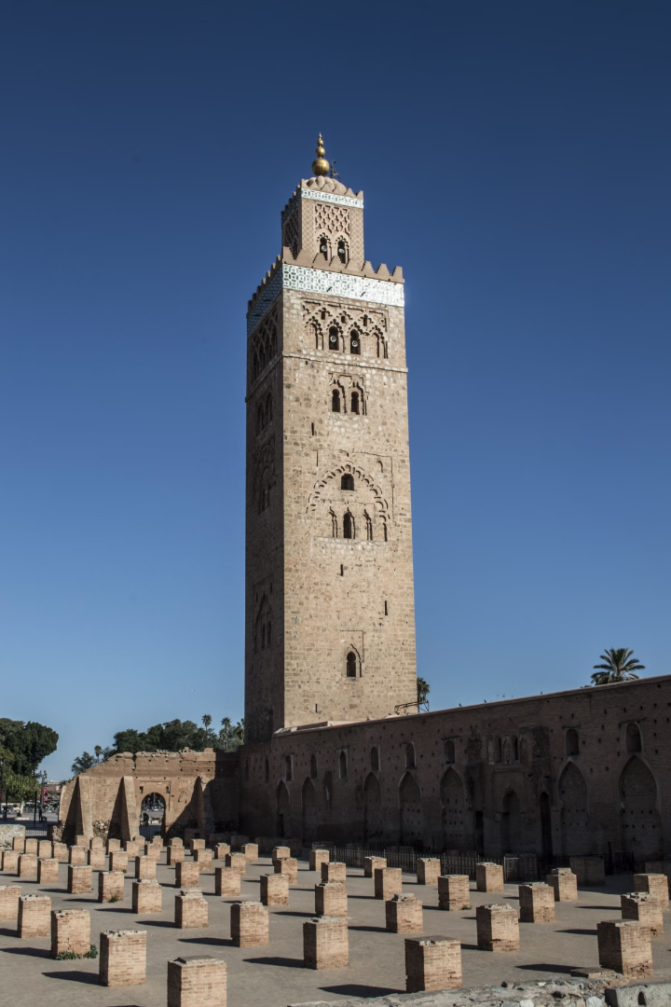


Some facts about Dhulikhel
Located around 30 km east of Kathmandu, Dhulikhel is a popular destination for both local and international tourists. It is known for its stunning mountain views, ancient temples, and cultural richness. The city offers a peaceful retreat and is frequented by visitors seeking a serene getaway.
by Atul Dhital

Slide 2
Destination Overview of Dhulikhel
1
Stunning Himalaya Views
In clear weather, snow-capped peaks of the Himalayan ranges from Mount Langtang (7,234m) in the west to Mount Everest (8,848m) in the east can be seen. Long views of agricultural land, including terraced rice fields and wooded regions, provide excellent chances for sight-seeing, particularly between October and March.
2
Adventure Tourism
Dhulikhel is a popular hiking and trekking destination, as well as mountain riding and cycling due to its clean environment, beauty, and links to cultural places. There are also several activities in the area, such as canyoning, bungee jumping, high rope, rafting, and bird viewing.
3
Agriculture Tourism
Dhulikhel has attracted agriculture-related value-added companies like cheese making with farm-gate retail and homestays. The homestay programs offer tourists the opportunity to experience the lifestyle and traditions of the local communities.

Slide 3
Dhulikhel’s Tourism Assets
Distinct Destinations
Physical Infrastructure
Dhulikhel’s cultural and tourism assets provide a snapshot of important tourism attractions, the obstacles associated with their development, sustainable management, and potential to further enhance assets or overcome growth constraints.
The physical infrastructure in Dhulikhel facilitates tourist transportation and visitor experience, contributing to the overall tourism appeal of the city.

Slide 4



Dhulikhel Tourism Landscape
Stunning Himalaya Views
Adventure Tourism
Agriculture Tourism
Dhulikhel is a popular hiking and trekking destination, as well as mountain riding and cycling due to its clean environment, beauty, and links to cultural places.
Dhulikhel has attracted agriculture-related value-added companies like cheese making with farm-gate retail and homestays.
In clear weather, snow-capped peaks of the Himalayan ranges from Mount Langtang (7,234m) in the west to Mount Everest (8,848m) in the east can be seen.

Slide 5
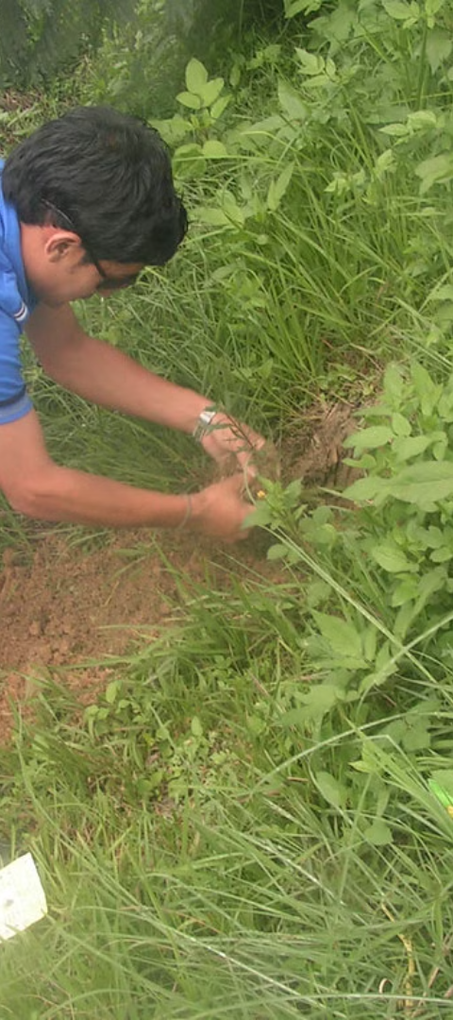
Tangible and Intangible Heritage
1
Intangible Heritage
2
Tangible Heritage Assets
Dhulikhel’s living heritage is both ‘intangible’ (cultural practices) and ‘tangible’ (physical).
Dhulikhel is blessed with many tangible built heritage assets including pagoda style temples, stone carved statues, shrines, and hitis.

Slide 6
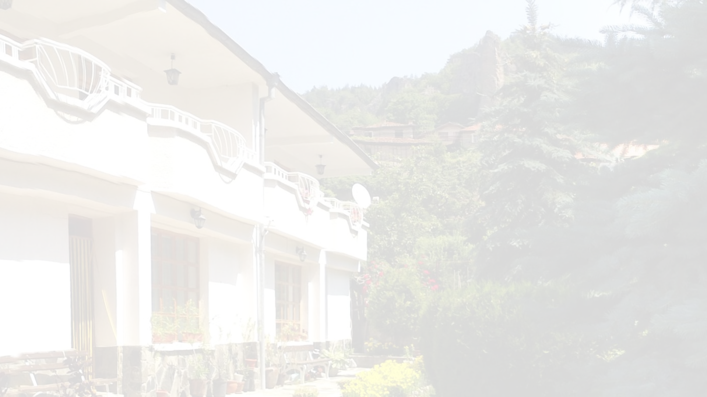
Tourist Accommodation
Diverse Accommodation Options
Accommodation Expansion
Dhulikhel has a diverse choice of accommodation options, including budget hotels, luxury hotels, and rural homestays.
New accommodation premises are the Municipality’s fastest expanding business category, offering a wide range of lodging options.

Slide 7
Community Forests and Population
36
37000
Total Community Forests
Average Total Population
Dhulikhel is home to a total of 36 community forests, covering an area of 8.53 sq.km.
The average total population in Dhulikhel is 37,000, with a ward density of 582.

Slide 8
Climate in the City
Minimum
0 degree Celsius
Maximum
35 degree Celsius
Average (Yearly)
1500mm

